Slide 1
尼諾思科技股份有限公司 報告人：teuton
Unit test & OOC 簡報

Slide 2
大綱
CGreen
OOC
Design Principle
Test double
Embedded TDD cycle

Slide 3
CGreen 簡介

Slide 4
What is CGreen?
open source unit tester for C and C++
apt-get install cgreenl
main.c
FirstTest.c
#include “TestFiles.c”
TestSuite *suite = create_test_suite();
add_suite(suite,FirstTest());
add_suite(suite,WordTest());
return run_test_suite(suite, create_text_reporter());
Ensure(FirstTest, oneshot){}
WordTest.c
Ensure(WordTest, count){}

Slide 5
How does CGreen resemble BDD?
Describe(Strlen);
BeforeEach(Strlen) {}
AfterEach(Strlen) {}
Ensure(Strlen, returns_five_for_hello) {
assert_that(strlen("Hello"), is_equal_to(5));
}
TestSuite *our_tests() {
TestSuite *suite = create_test_suite();
add_test_with_context(suite, Strlen, returns_five_for_hello);
return suite;
}

Slide 6
CGreen constraints example
is_true, is_non_null (Basic)
is_equal_to(value), is_less_than(value) (Integer)
is_equal_to_string(value), ends_with_string(value) (String)
is_equal_to_double(value), is_greater_than_double(value) (Double)
assert_that(expected, constraint)
assert_that_double(expected, constraint)

Slide 7
OOC

Slide 8
Encapsulation
struct ShapeVtbl; /* forward declaration */
typedef struct {
struct ShapeVtbl *vptr; /* <== Shape's Virtual Pointer */
char* __name;
double __x;
double __y;
}Shape;

Slide 9
Encapsulation
/* Shape's operations (Shape's interface)... */
void Shape_ctor(Shape * this, const char* name, double x, double y);
void Shape_moveby(Shape * this, double dx, double dy);
char* Shape_getname(Shape * this);
double Shape_gety(Shape * this);
void Shape_setx(Shape * this, double x);

Slide 10
Encapsulation
/* Shape's prototypes of its virtual functions */
static void Shape_xtor_(Shape * this);
/* object constructor*/
void Shape_ctor(Shape * this, const char* name, double x, double y){
static struct ShapeVtbl vtbl = { /*vtbl of the Shape class */
&Shape_xtor_
/* initialize other virtual functions here */}
/* initialize other object variables here */}

Slide 11
Encapsulation
Shape test_sq;
Shape_ctor(&test_sq, "sqareTS", 2.1, 3.3);
assert_that(Shape_getname(&test_sq), is_equal_to_string("sqareTS"));
Shape_moveby(&test_sq, 1.1, 2.3);
Shape_sety(&test_sq, 2.7);

Slide 12
Inheritance
/* Rectangle's attributes... */
typedef struct {
Shape super; /* <== inherits Shape */
/* attributes added by this subclass... */
double __width;
double __height;
} Rectangle;
double Rectangle_getWidth(Rectangle * this);

Slide 13
Inheritance
static void Rectangle_xtor_(Shape * this); // into vtable
void Rectangle_ctor(Rectangle * this, char* name, double x, double y, double width, double height){
/* initialize vtbl here*/
Shape_ctor(&this->super, name, x, y);
this->super.vptr = &vtbl; /* override the vptr */
/* initialize other Rectangle object variable here */}

Slide 14
Inheritance
Rectangle_ctor(&rec, "rect3", 2.1, 3.2, 4.5, 5.4);
assert_that_double(Rectangle_getHeight(&rec), is_equal_to_double(5.4));
assert_that(Shape_getname(&rec.super), is_equal_to_string("rect3"));
Shape_moveby(&rec.super, 1.1, 2.2);

Slide 15
Polymorphism
struct ShapeVtbl{
void (*xtor)(Shape * this);
double (*area)(Shape * this);
void (*draw)(Shape * this);
};

Slide 16
Polymorphism
static inline double Shape_area(Shape * this) {
return (*this->vptr->area)(this);
}
static inline void Shape_draw(Shape * this) {
(*this->vptr->draw)(this);
}

Slide 17
Polymorphism
assert_that_double(Shape_area(&cir.super), is_equal_to_double(12.56));
assert_that_double(Shape_area(&rec2.super), is_equal_to_double(15.0));

Slide 18
Design principle

Slide 19
Single responsibility principle (bad)
A class should have one and only one reason to change, meaning that a class should have only one job.
double Shape_area_sum(Shape* [] shapes, int nShapes) {
/* iterate shapes and get sum here*/ /* print result here */ /* that’s two things! */
/* what if I change sum or print and affect each other? */
}

Slide 20
Single responsibility principle (fixed)
double Shape_area_sum_calculate(Shape* [] shapes, int nShapes) {
/* iterate shapes and get sum, return result here*/
}
void Shape_area_sum_print(double sums) {
/* print result here*/
}

Slide 21
Open closed principle (bad)
Objects or entities should be open for extension but closed for modification.
for (i = 0, i < nShapes, i++) {
if ( /* this is circle*/) {
/* calculate circle area */
} else if ( /* this is rectangle */) {
/* calculate circle area */
}
/* what if there are additional shapes? */
}

Slide 22
Open closed principle (fixed)
/* use Polymorphism here */
for (i = 0, i < nShapes, i++) {
sum += Shape_area(shapes[i]);
}

Slide 23
Liskov substitution principle (bad)
Let q(x) be a property provable about objects of x of type T. Then q(y) should be provable for objects y of type S where S is a subtype of T.
typedef struct {
struct studentTicket;
} Child;
typedef struct {
Child super;
/* how do I use studentTicket? */
} Adult;

Slide 24
Interface segregation principle (bad)
A client should never be forced to implement an interface that it doesn’t use, or clients shouldn’t be forced to depend on methods they do not use.
typedef struct {
double (*volume)(Shape*);
} Shape; typedef struct {
Shape super;
/* why should I use volume? */
} Square;

Slide 25
Interface segregation principle (fixed)
typedef struct {
Shape super;
double (*area)(Shape*);
} 2DShape;
typedef struct {
Shape super;
double (*volume)(Shape*);
} 3DShape;

Slide 26
Dependency inversion principle (bad)
Entities must depend on abstractions, not on concretions. It states that the high-level module must not depend on the low-level module, but they should depend on abstractions.
dbConn = connect(MySQLConnection dbConnection);
/* What if MySQL is changed into Mongal DB? */

Slide 27
Dependency inversion principle (fixed)
typedef struct {
Connection super;
} MySQLCConn;
typedef struct {
Connection super;
} MongalDBCConn;
dbConn = connect(Connection dbConnection);

Slide 28
Tests are FIRST
Fast
Isolated
Repeatable
Self-verifying
Timely

Slide 29
Test Double

Slide 30
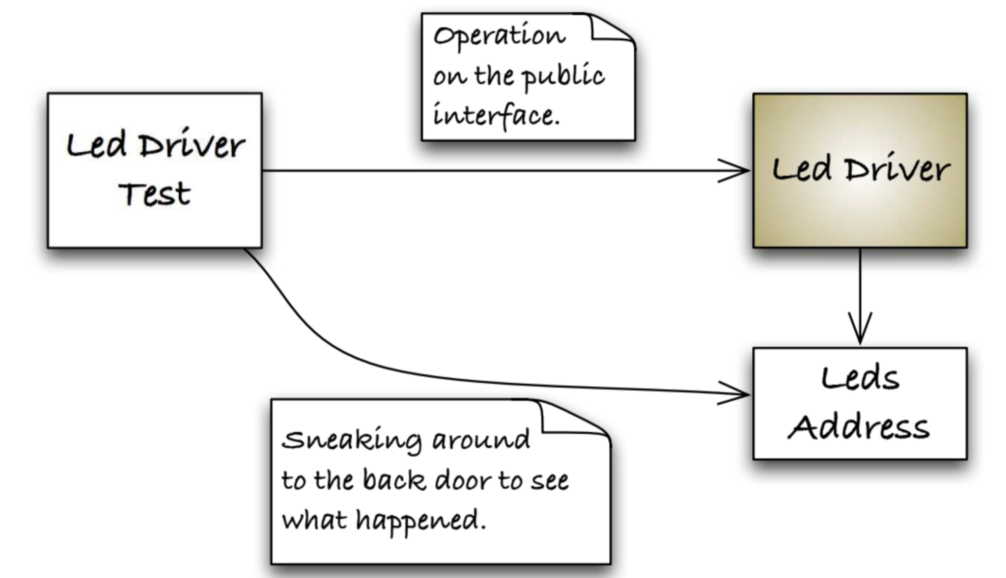
How do you test outside CUT?

Slide 31
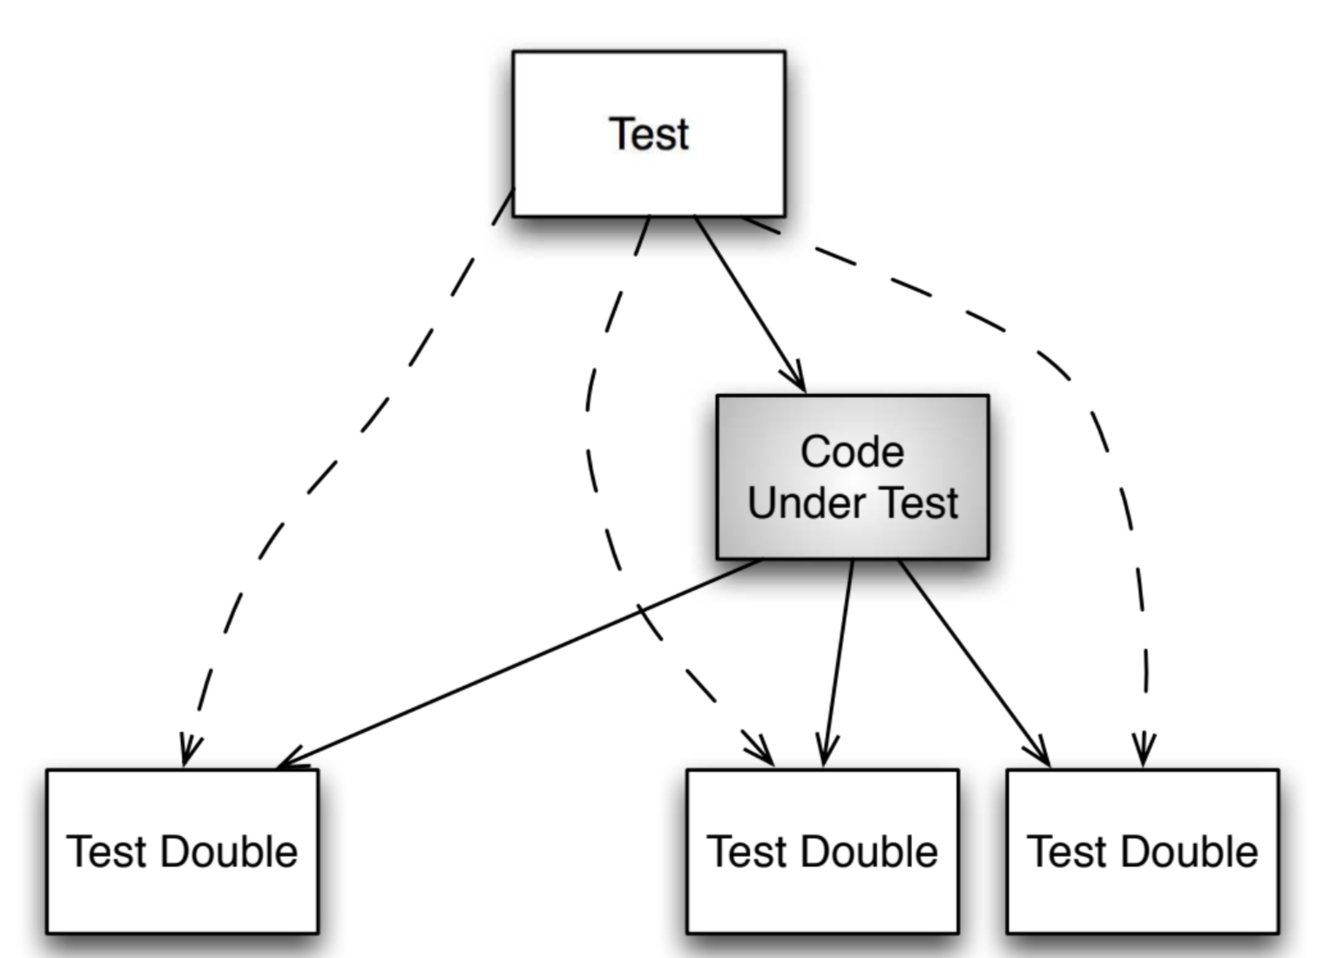
Simpliffy relationship

Slide 32
When to use test double?
Hardware independence
Inject difficult to produce input(s)
Speed up a slow collaborator
Dependency on something volatile (e.g. Time)
Dependency on something under development
Dependency on something that is difficult to configure

Slide 33
Test dummy
“I exist”
void Nothing(DummyOb* obj){}

Slide 34
Test stub
return some value
int Stub_add_up(StubOb* obj){
return 3;
}
assert_that(Stub_add_up(&stuby), is_equal_to(3));

Slide 35
Test spy
Capture parameter
int Spy_add_up(SpyOb* obj){
obj->called_add = true;
return obj->a + obj->b;
}
assert_that(Spy_add_up(&spyy), is_equal_to(3));
assert_that(spyy.called_add, is_true);

Slide 36
Mock object
Verify function called
void mocked_callback(int x, int y) {mock(x, y);}
void Mock_add_more(MockOb* obj){
mocked_callback(obj->a, obj->b);
obj->a += 1;
obj->b += 2;
mocked_callback(obj->a, obj->b);}

Slide 37
Mock object
expect(mocked_callback,
when(x, is_equal_to(2)),
when(y, is_equal_to(1)));
expect(mocked_callback,
when(x, is_equal_to(3)),
when(y, is_equal_to(3)));
Mock_add_more(&mocky);

Slide 38
Embedded TDD Cycle

Slide 39
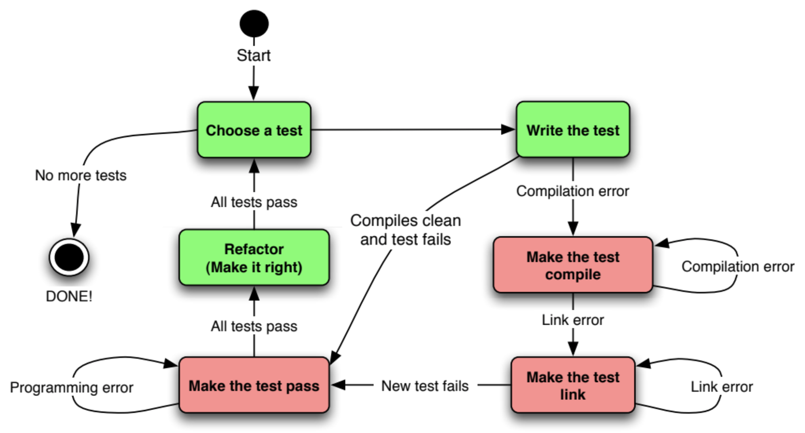
TDD cycle

Slide 40
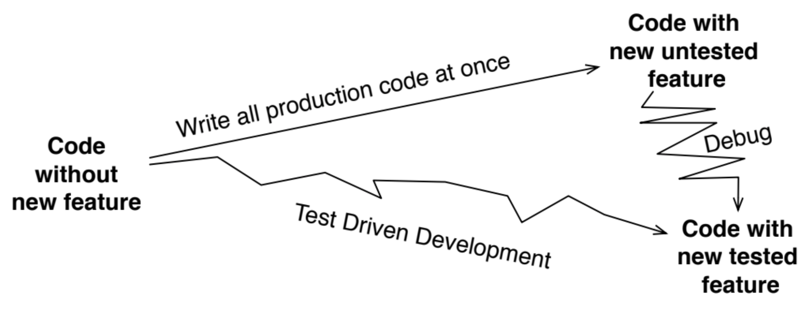
Why TDD?

Slide 41
The target hardware bottleneck
Target hardware is not ready
Target hardware is expensive/scarce
Target hardware may have bug of its own
Longer target build time
Longer target upload time
Compiler difference

Slide 42
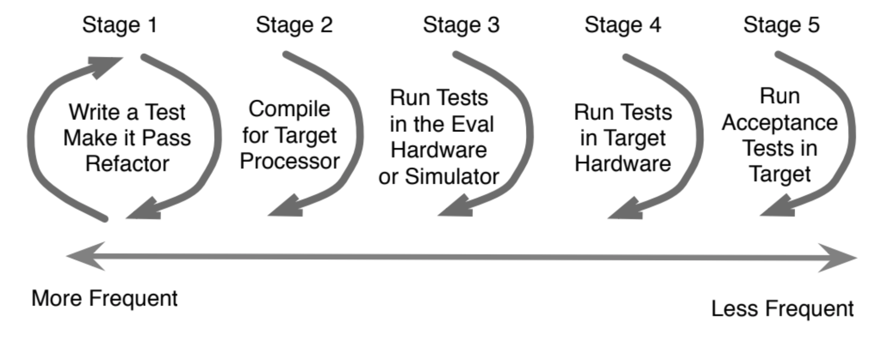
Embedded TDD Cycle

Slide 43
Thank You. 簡報完畢

